Slide 1
1.1 Overview of JDemetra+
ESTP Training
05-07 October 2026

Slide 2
0. Outline
Objectives of JDemetra+ (JD+)
  General
  For seasonal adjustment (SA)
What is really JD+ ?
Statistical content
Seasonal adjustment framework
Final remarks

Slide 3
1.1 General Objectives
Providing algorithms for the production/analysis of [official] statistics
  Regular time series (from monthly to yearly)
  Algorithms for
    Seasonal adjustment, business cycle analysis
    Benchmarking, temporal disaggregation
    Modelling (forecasting, estimation of missing values, outliers detection)
Reusable modules, compatible with common IT infrastructure
  Java, R, WEB services...
Designed for the whole statistical process
  From research to bulk production (flexible, high-performance)
Maintainable
  Open-source solution

Slide 4
1.2 Objectives for SA
Java implementation of the leading algorithms
  TRAMO-SEATS, X12-ARIMA...
Flexible design
  Easier modifications of the core engines
  Developments of additional tools/algorithms
Challenge
  Keeping similar results and high performances
  with flexible (more general) design and algorithms and slower technical solution

Slide 5
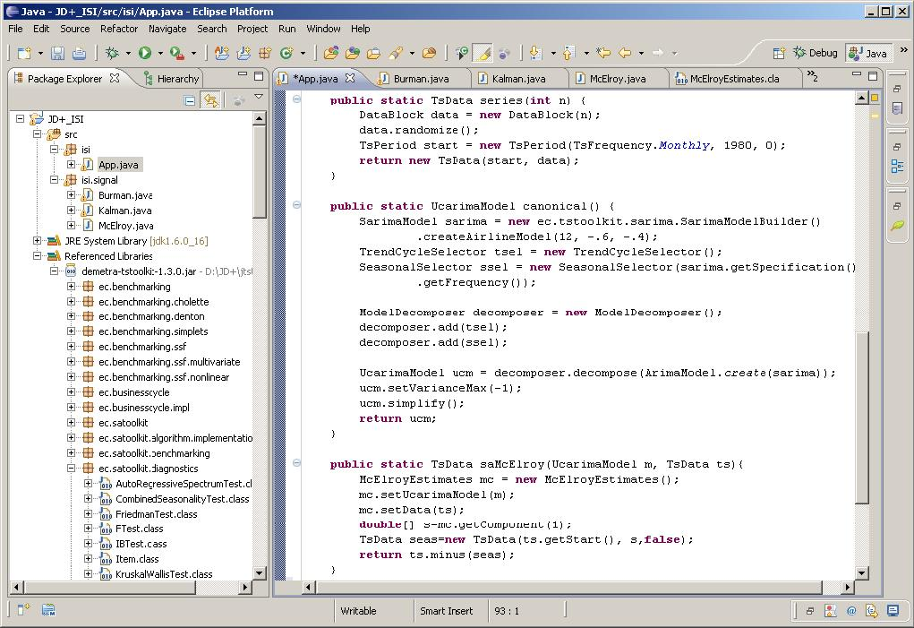
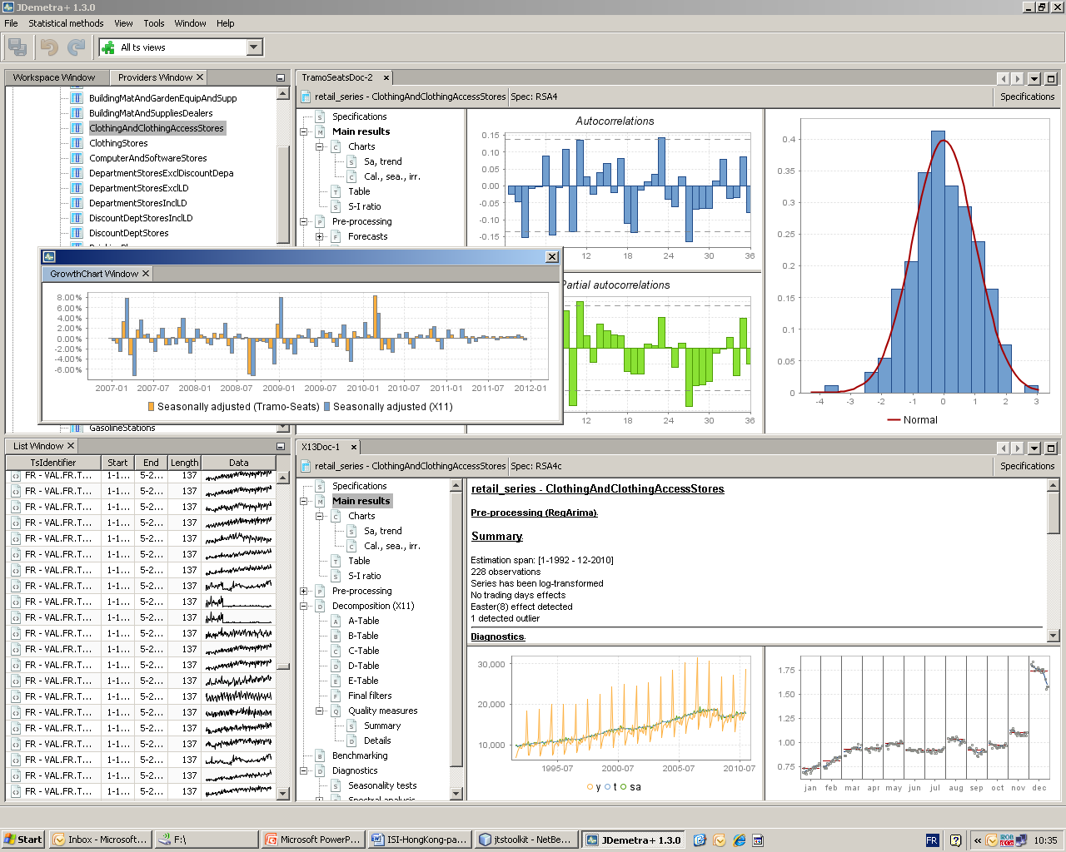
2.1 What is JD+ (I) ?
Advanced Java toolkit for time series (SA) processing (IT-teams, researchers)
Rich graphical application (end-users)

Slide 6
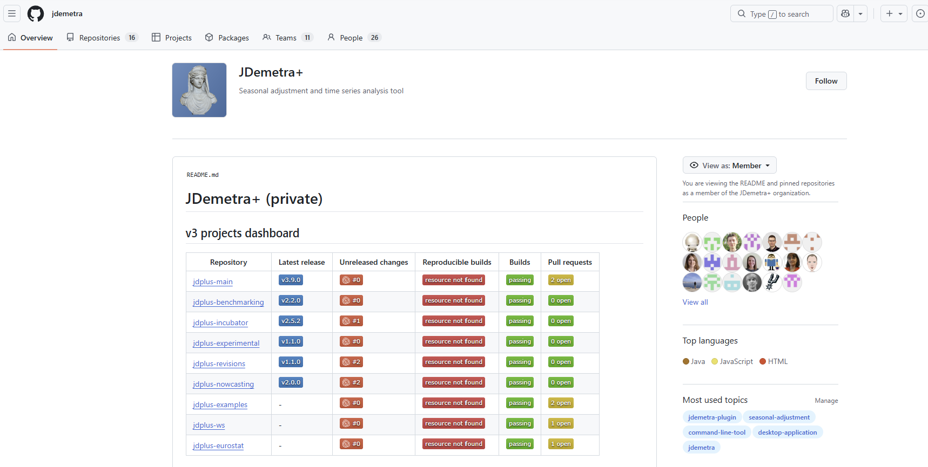
2.2 What is JD+ ? (II)
Open Source project
(EUPL license)
Supported by Eurostat
Developers:
  NBB
  Bundesbank
  INSEE
  ...
Originally based on:
  Tramo-Seats (BDE)
  X12-Arima (USCB)
https://github.com/jdemetra

Slide 7
3. Statistical content
Basic data handling
Basic econometrics
Tramo
Benchmarking, temporal disaggregation
Matrix computation
Arima modelling
RegArima
Complex, polynomials
Structural models...
VAR,
Dynamic factor model
Linear filters
Seasonal adjustment
X11
Seats
High frequency
Function optimization
Arima, Ucarima
STL
Revisions analysis
Basic statistics
Utilities...
State space framework
Time series, calendars, regression variables...

Slide 8
4. Seasonal adjustment framework
Generic modules:
Analysis
  Seasonality tests
  Revision analysis
  Sliding spans
I/O (common xml schema)
Graphical components
  Charts
  SI ratios...
SA methods
Specific modules
(X11, STL...)
Tramo-Seats, X12-Arima...
REGARIMA modules:
Common model
Estimation tools
Automatic modelling routines
Analysis tools (residuals, forecasts...)
Graphical components
REGARIMA pre-processing
Other filters (X11, STL...)
Model-based decomposition
(canonical decomposition,
structural models...)
Signal extraction tools:
Estimation
Analysis
Graphical components

Slide 9
5. Final remarks
JD+ is a complete re-factoring of Tramo-Seats and of X12-Arima in an open OO framework. In some cases, the new algorithms may lead to (usually slightly) different results .
JD+ is also designed for the handling of related time series problems, especially through a rich state space library.
By developing it as an open-source solution, we have tried to create an environment appropriate to external collaborations.

